Slide 1

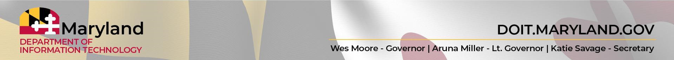
Maryland AI Community of Practice (MDAI)
06/05/2026
Image is royalty-free from Pixabay

Slide 2
Agenda
Welcome and Introduction to the AI CoP (Lauren Maffeo, DoIT)
Holding AI to Standards (Dex-Xavier Copeland, DoIT)
Maryland Data Academy: Building an AI-Ready Workforce (Stephanie Garland, DoIT)
What’s Next (Lauren Maffeo, DoIT)
Image is royalty-free from Pixabay

Slide 3
Mics on Mute to prevent background noise
Only the speaker should have their camera on to avoid visual distractions
Add your questions to the Comments or Q&A section of our chat
The AI Enablement Team will try and address questions in the chat async
Forward this meeting to peers who might benefit (https://meet.google.com/cbi-iazh-ccn )
Bring an owner’s mindset & participate!
CoP Etiquette
Image is royalty-free from Pixabay

Slide 4
MDAI’s Vision & Values
Image is royalty-free from Pixabay

Slide 5
Maryland’s Vision for AI
The State of Maryland responsibly, ethically, and productively leverages AI/ML technologies to significantly improve constituent outcomes and reduce drudgery for the State workforce.
Image is royalty-free from Pixabay

Slide 6
MDAI’s Values
Collaborate Across Teams
    Meet regularly to share AI use cases, wins, struggles, questions, and best practices.
    Provide shared space for anyone in Maryland to learn how they can harness AI.
    Connect with peers who have the same issues or aspects of AI enablement as you do.
Image is royalty-free from Pixabay

Slide 7
MDAI’s Values
2) Show, Don’t Tell
    Host lunch n’ learns to show how Maryland’s civil servants can use enterprise AI tools.
    Share AI proofs of concept to demo how your peers use AI.
    Highlight guest speakers beyond government to share new AI innovations.
Image is royalty-free from Pixabay

Slide 8
MDAI’s Values
3) Provide AI Updates in a Shared Space
    Share new AI policies, processes, guidance, etc. for state employees to use.
- Offer blueprints for anyone serving Maryland (city, county, state, etc.) to leverage AI.
- Provide Maryland’s AIE team as a foundational source for where to start with AI.
Image is royalty-free from Pixabay

Slide 9
Holding AI to Standards
Dex-Xavier Copeland, GRC Engineer, DoIT
Image is royalty-free from Pixabay

Slide 10
Holding AI to Standards: Overview
The Problem
Demo Scenario
A Three-Pillar Framework Solution
  Sources
  Benchmarks
  Feedback
Conclusion
Q&A

Slide 11
The Problem
AI outputs are only as good as the standard you hold them to.
Without a clear benchmark, we often default to gut instinct, which produces:
Inconsistent Assessments – same request, two reviewers, two answers
Undocumented Rationale – decisions we can’t defend later
No Reusable Institutional Knowledge – every review restarts from zero

Slide 12
Demo Scenario
AI Use Case Intake Review Process
Users submit their use-case with details
Reviews are performed using Gemini
Gemini produces the same recommendation, but quality of the recommendation remains inconsistent
Complaints from various sources start rolling in

Slide 13
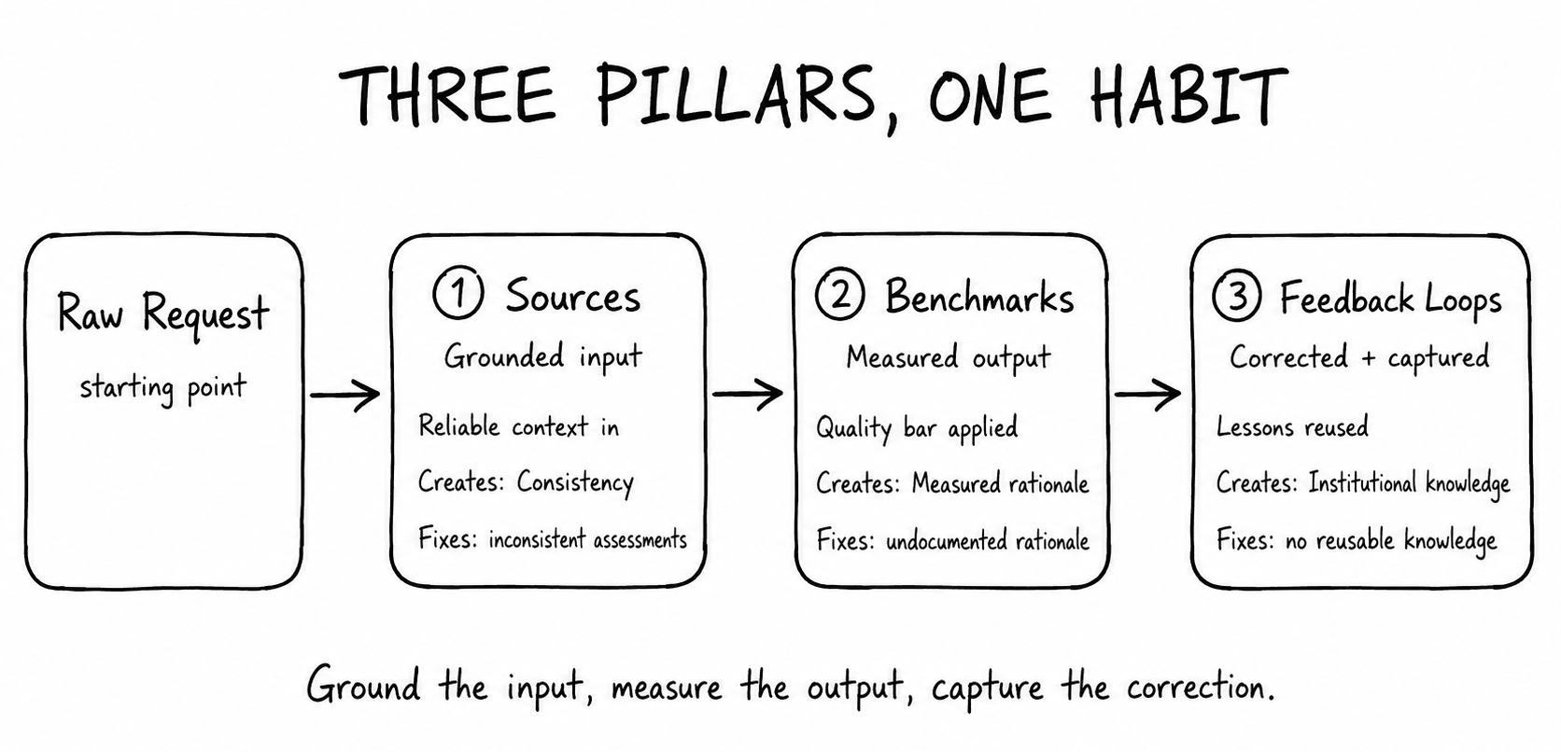

Slide 14
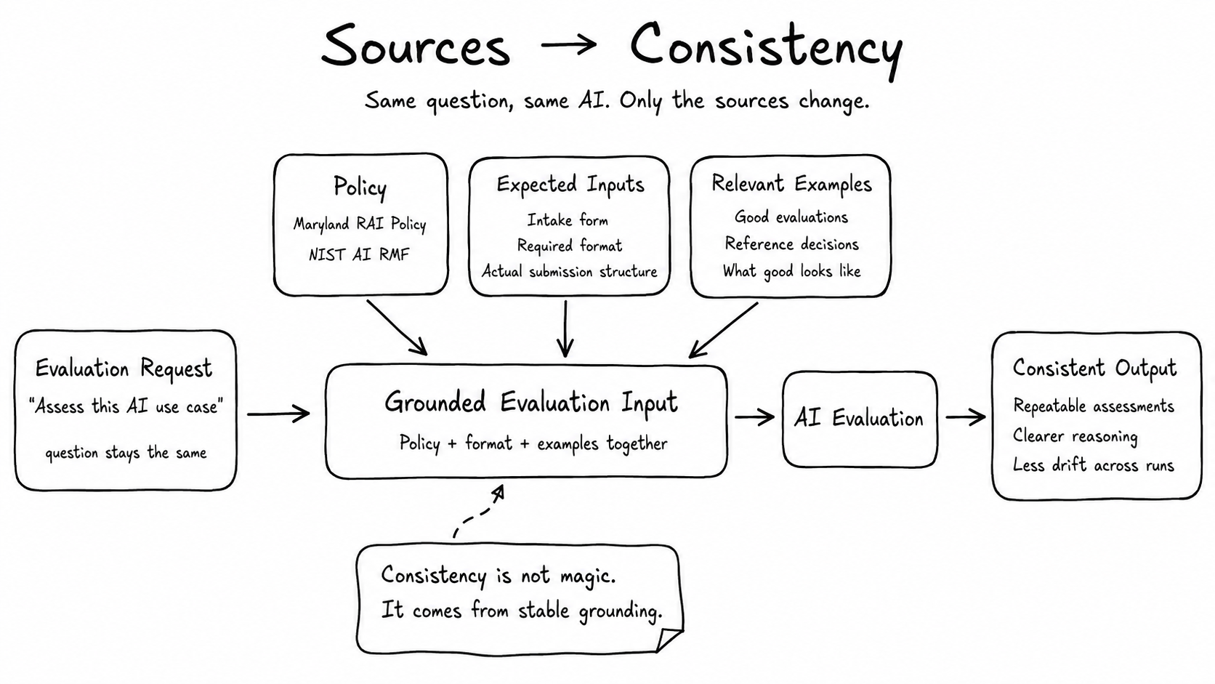

Slide 15
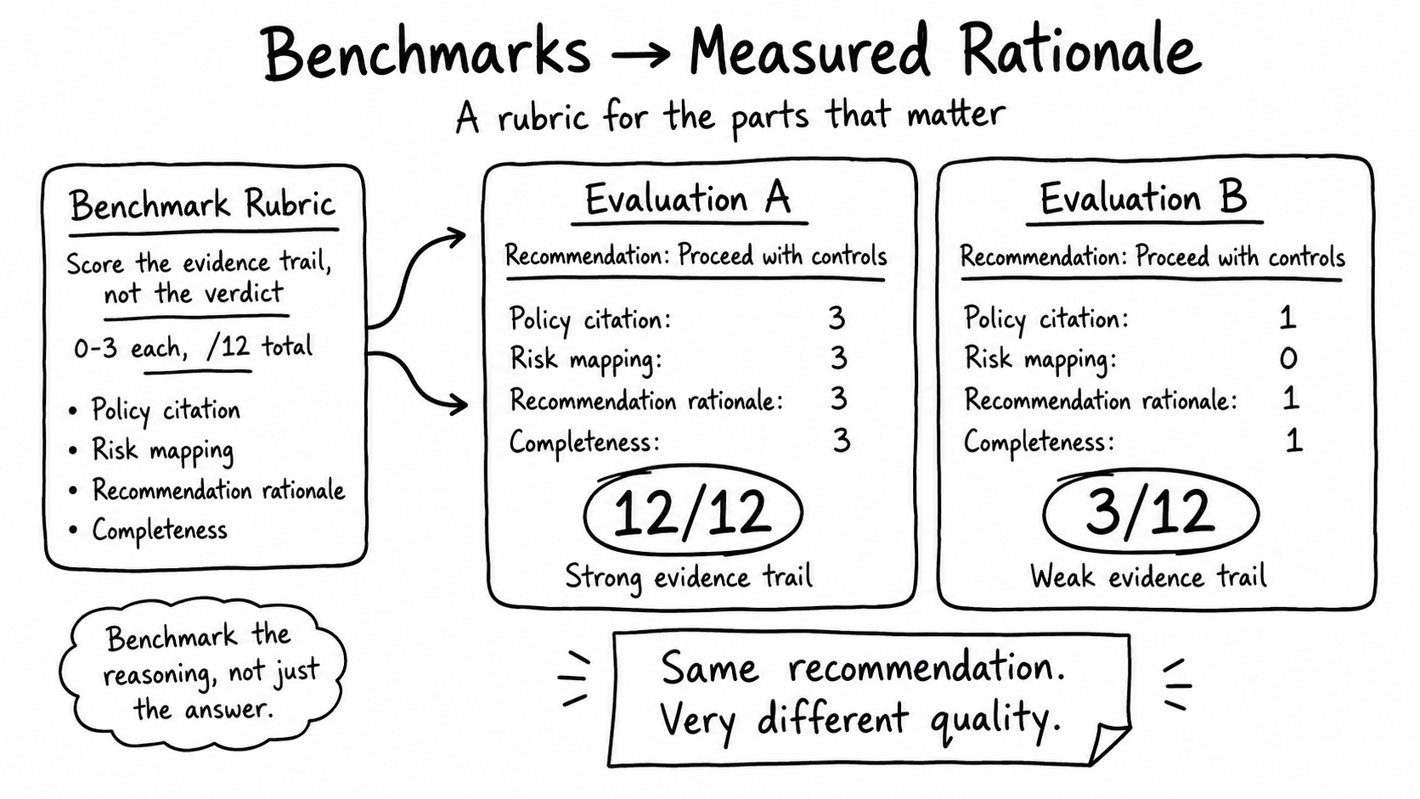

Slide 16
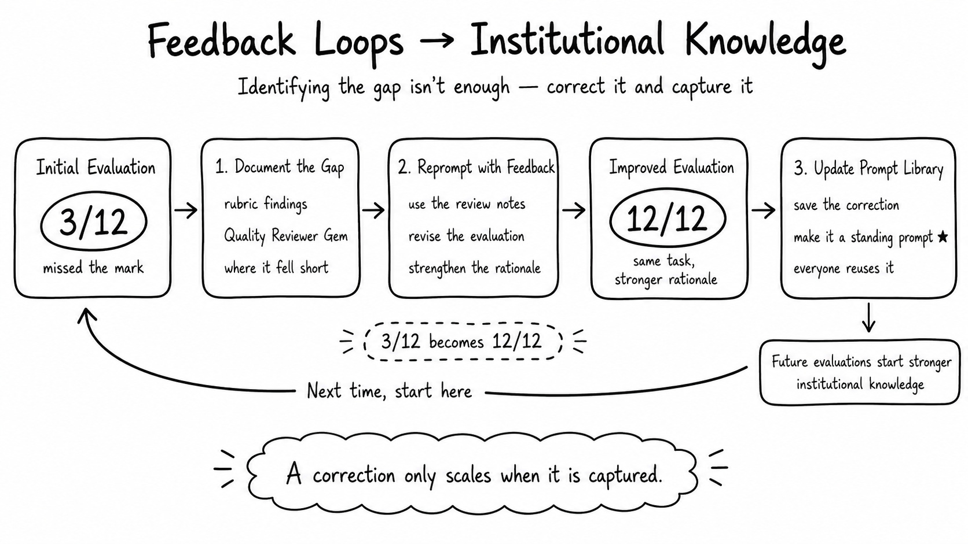

Slide 17
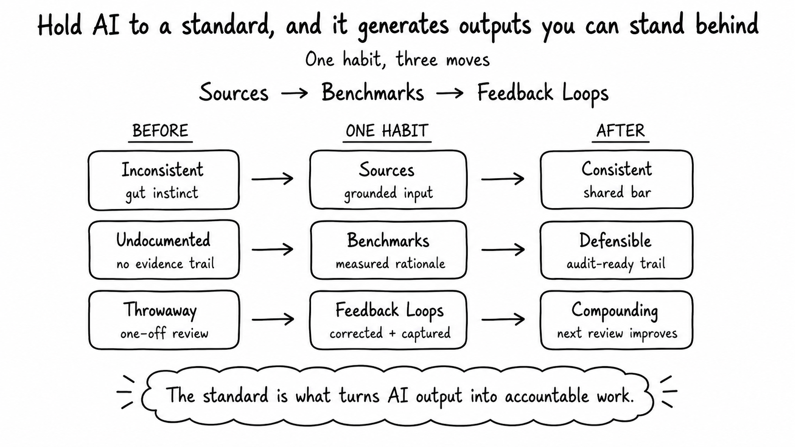

Slide 18
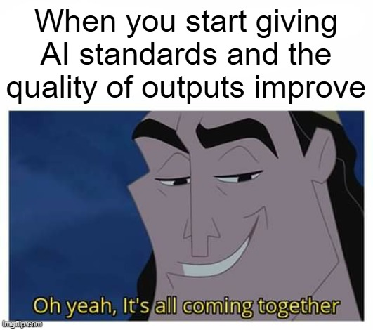
Q&A

Slide 19
Maryland Data Academy :
Building an Data AI-Ready Workforce
Stephanie Garland, Director of Data Literacy, DoIT
Image is royalty-free from Pixabay

Slide 20
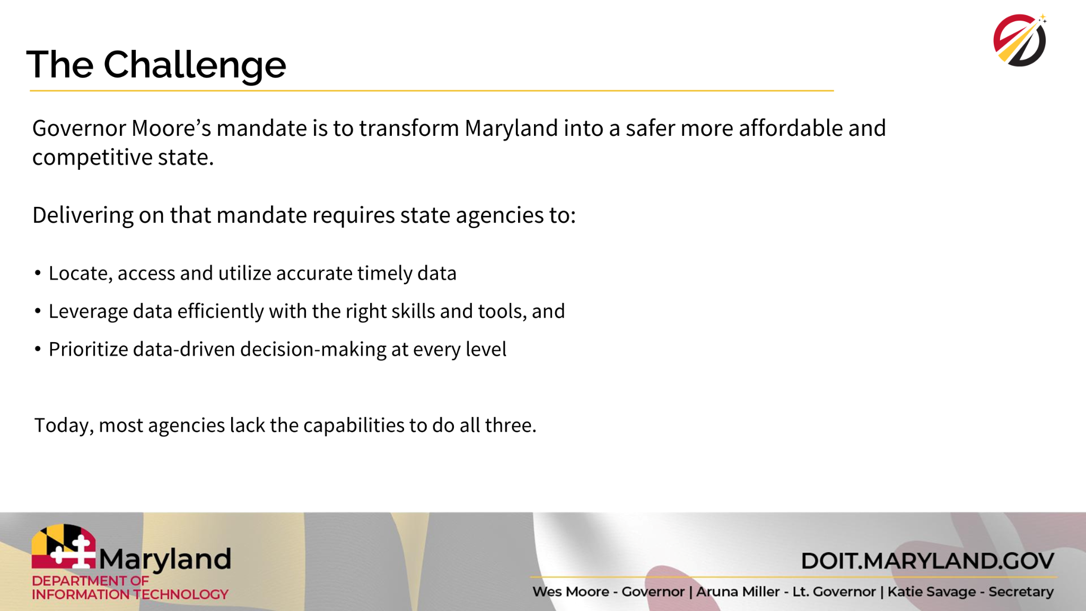

Slide 21
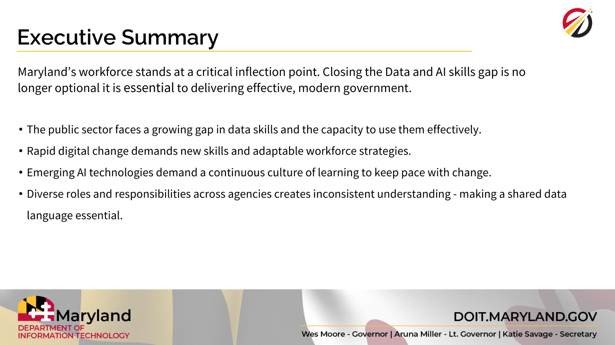
Maryland Data Academy
Building a Data AI - Ready Workforce
Image is royalty-free from Pixabay

Slide 22
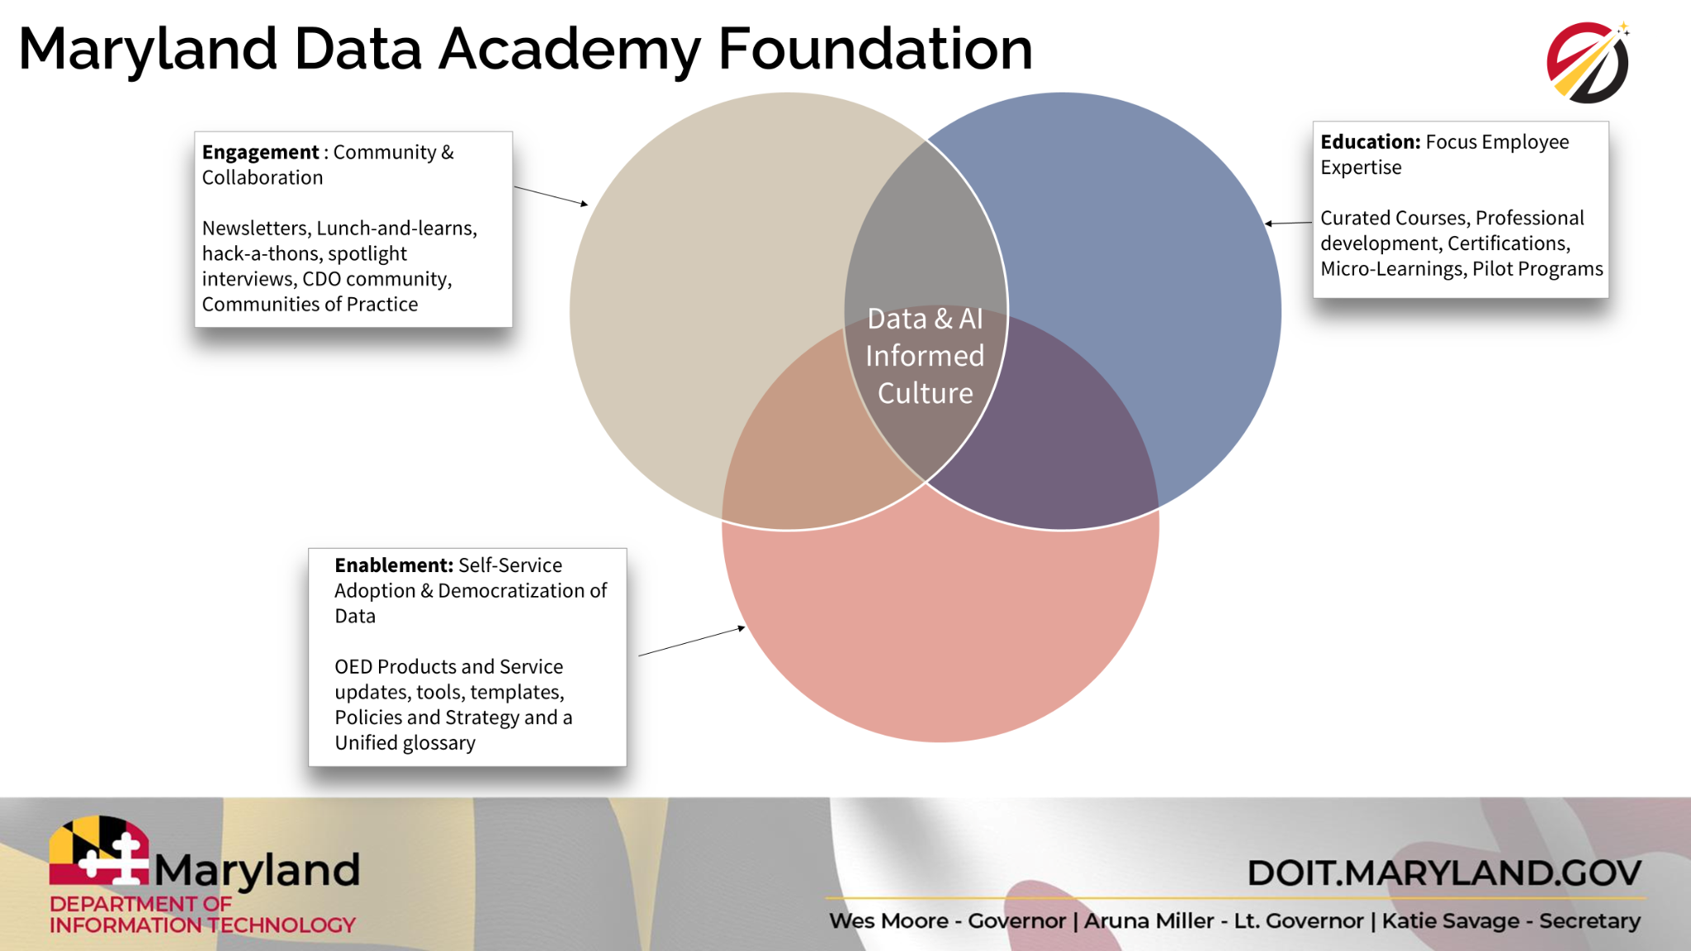

Slide 23
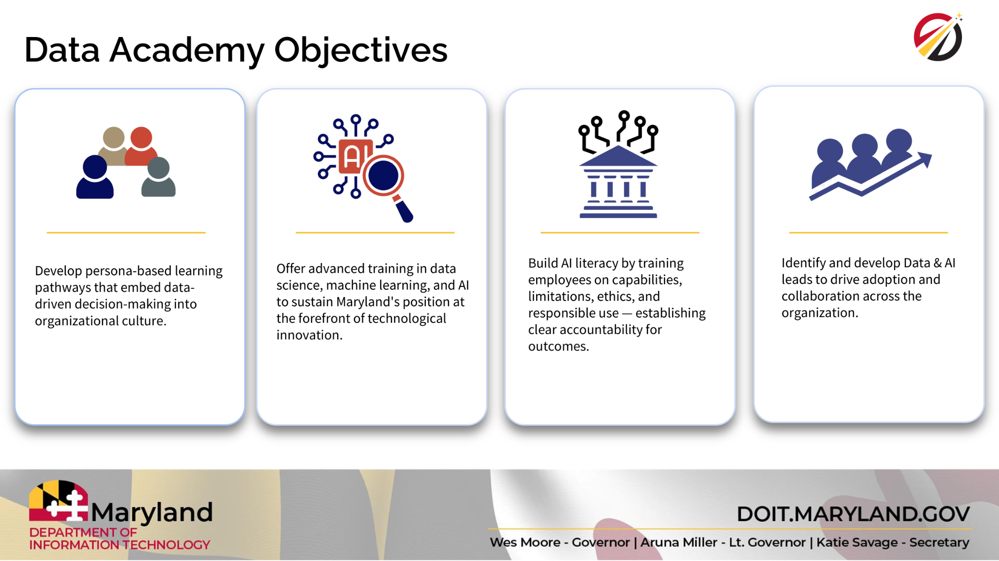

Slide 24
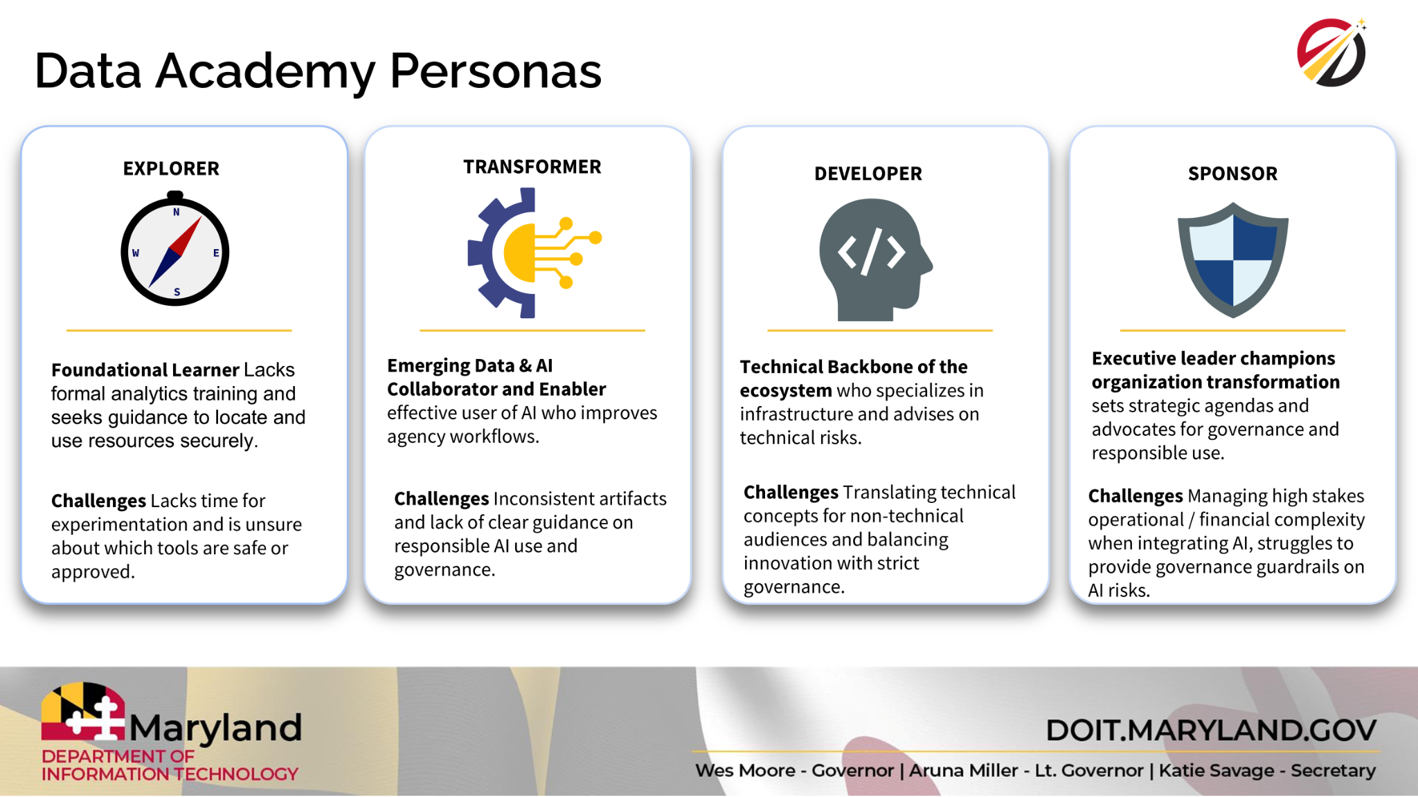

Slide 25
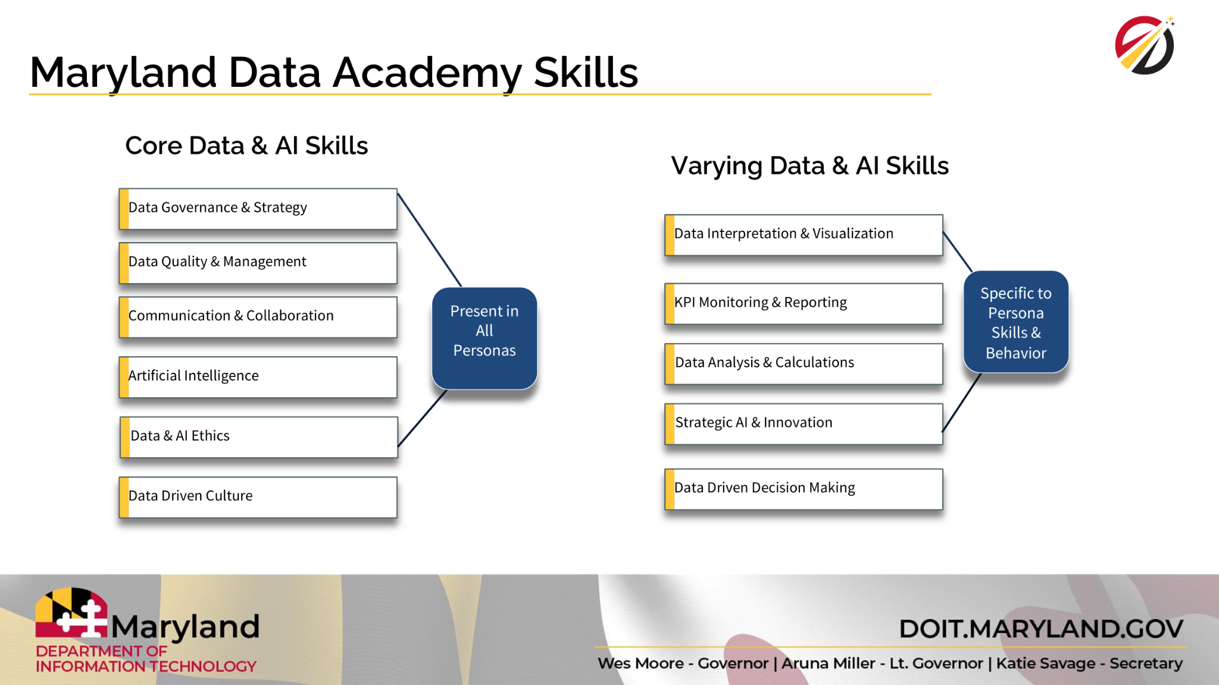

Slide 26
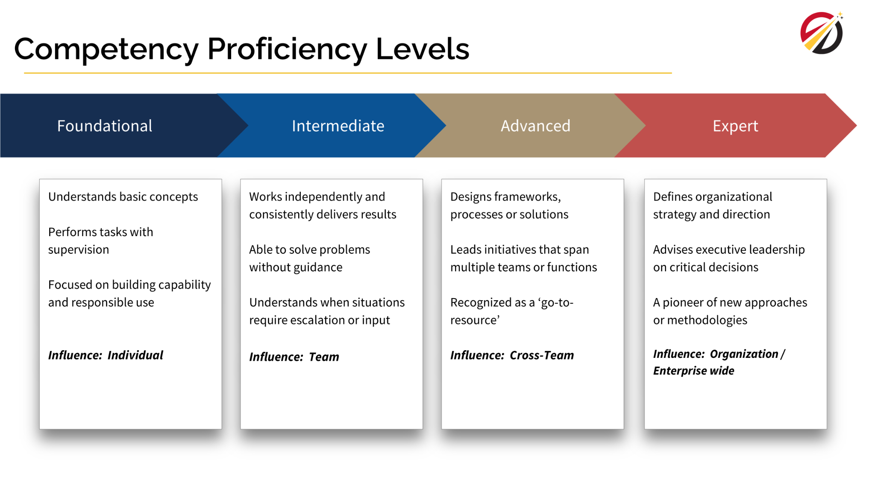

Slide 27
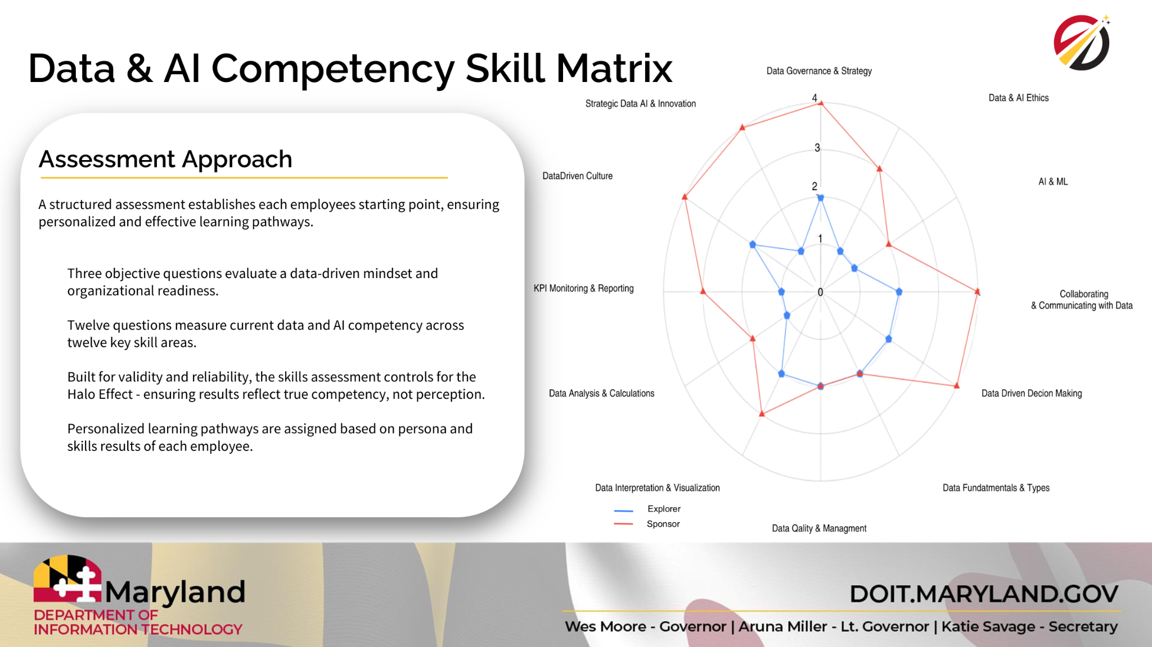

Slide 28
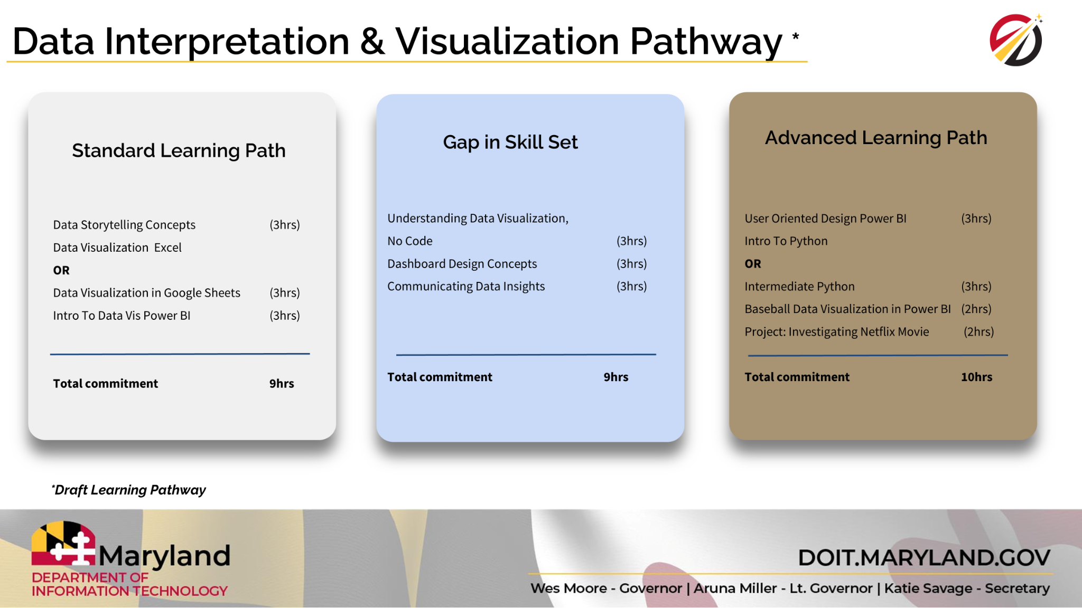

Slide 29
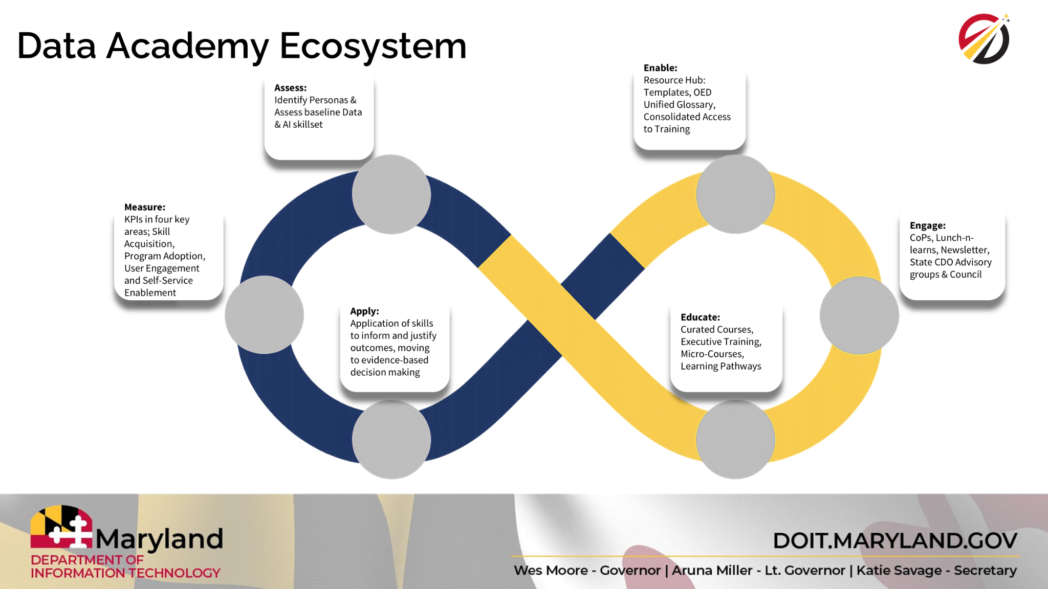

Slide 30
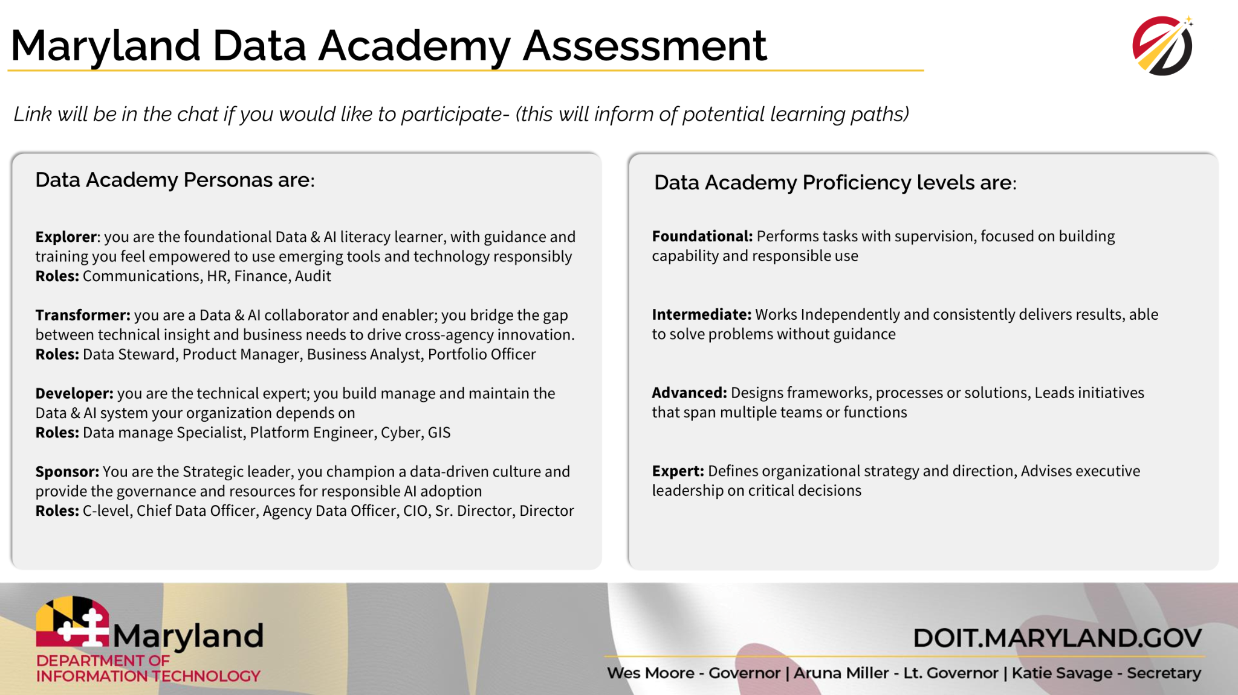

Slide 31
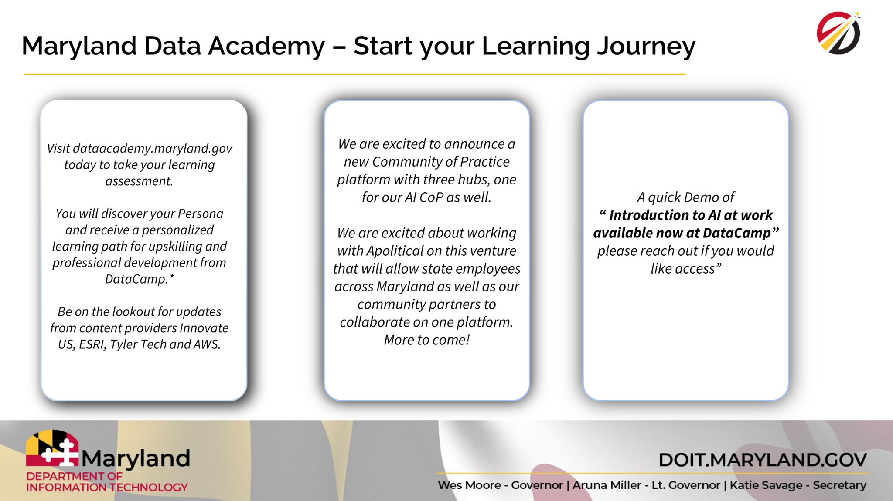

Slide 32
We meet each 1st Friday per month
Forward this invite to colleagues who might be interested in joining
Submit your AI use cases to our inventory
Book MDAI Office Hours
Email AI@Maryland.gov to show your team’s AI work at a future CoP!
What’s Next?
Image is royalty-free from Pixabay

